Slide 1
Compton Effect
Ashish M. Desai
Assistant Professor
Department of Physics
amd006@chowgules.ac.in

Slide 2
Outline
Introduction
Experimental demonstration of the Compton effect
Equation of Compton Shift
Conclusion

Slide 3
Learning Outcomes
The Learner will be able to
understand the experimental arrangement and results of the Compton effect.
understand the equation of Compton shift

Slide 4
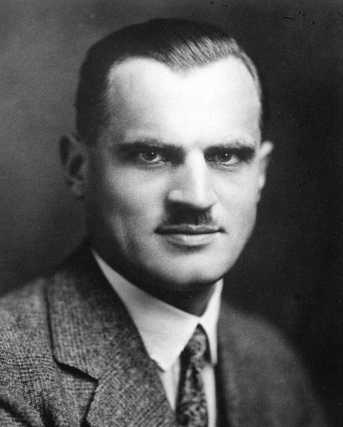
Introduction to Compton Effect
Arthur Holly Compton in 1923 assumed that a photon not only carries a quantity of energy hν, but it also has certain momentum like a material particle.
If a photon of energy hν strikes an electron it will transfer kinetic energy to the electron and will itself loose energy. The scattered photon will hence have a smaller energy hν’ and higher wavelength than that of the incident photon.
The observed change in frequency or wavelength of a scattered photon is known as Compton shift.
Arthur Compton
“Arthur Compton.jpg” by Unknown author, is retrieved from, http://www.gettyimages.co.uk/detail/news-photo/portrait-of-the-american-physicist-arthur-compton-x-ray-news-photo/141551127 licenced by CC- BT-SA 4.0

Slide 5
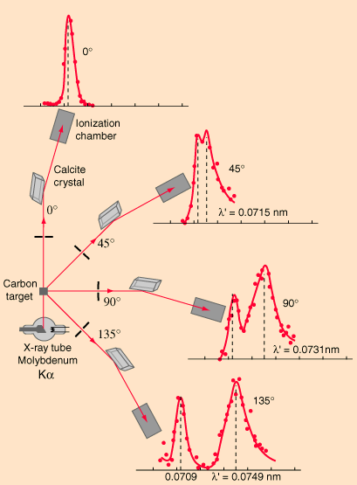
Experimental demonstration of Compton effect
A monochromatic X-ray is directed at the target and scattered X-rays are determined at various angles θ.
The distributions of intensity of the scattered X – rays are plotted as a function of their wavelength at different scattering angles.
“Compton Scattering Data” by Rod Nave, Georgia State University, is retrieved from http://hyperphysics.phyastr.gsu.edu/hbase/quantum/ compdat.html#c1 used with permission of the author.

Slide 6
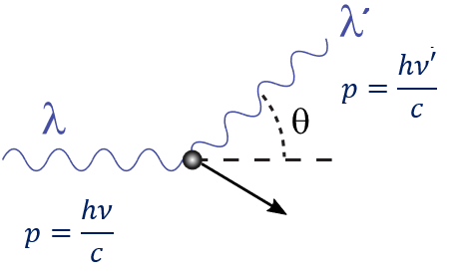
Equation of Compton Shift
An X-ray photon of wavelength $λ$strikes a free electron at rest.
After collision, the photon is scattered at an angle $θ$with increased wavelength $λ^{′}.$
The Compton shift is given as
$$Δλ=λ^{′}−λ=\frac{h}{m_{0}c}(1−\cos{θ)}$$
$m_{0}$ is the rest mass of electron.
“Compton-scattering.svg” by Jabberwok, is retrieved from, https://hi.wikipedia.org/wiki/%E0%A4%9A%E0%A4%BF%E0%A4%A4%E0%A5%8D%E0%A4%B0:Compton-scattering.svg is licenced by CC- BT-SA 3.0

Slide 7
Conclusion
Classical wave theory of light failed to explain the scattering of X-rays from electrons.
Compton by assuming particle nature of light and applying conservation of energy and conservation of momentum to the collision between the photon and the electron obtained the equation of the Compton shift that explained the experimental data.
The results of Compton effect further confirmed the particle nature of light.

Slide 8
References
Beiser, A. (1969). Perspectives of Modern Physics. Singapore: McGraw-Hill Book Company
.
Eisberg, R., & Resnick, R. (2010). Quantum Physics of Atoms, Molecules, Solids, Nuclei and Particles (2nd ed.). New Delhi: Wiley India Pvt Ltd.

Slide 9
Concept check-1
The change in wavelength in Compton scattering depends on
Angle θ of scattering.
Atomic number of scatterer.
Wavelength of incident X rays.
Nature of scatterer.

Slide 10
Concept check-2
If the photon gets scattered of a neutron instead of an electron, then the shift in wavelength between the incident and scattered photon
increases
decreases
remains same

Slide 11
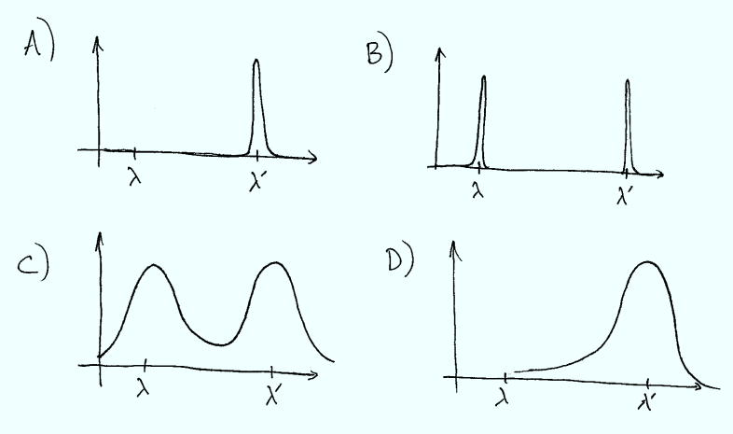
Concept check-3
In an actual Compton effect experiment electrons in the metal have random velocities (i.e. are only at rest on average). If we measure the intensity of scattered light at a fixed angle as a function of wavelength, what would we expect to observe.

Slide 12
Concept Check 4
The existence of the unmodified component of the scattered radiation, which has the same wavelength as the incident radiation, is due to the
Scattering from a free electron having low velocity.
Scattering from a tightly bound electron.
Unscattered Radiation.
Two of the above.
All of the above
“Compton Scattering Data” by Rod Nave, Georgia State University, is retrieved from http://hyperphysics.phyastr.gsu.edu/hbase/quantum/ compdat.html#c1 is used with permission of the author.

